Slide 1

Unsupervised Learning Algorithms
Agenda
Introduction to Hierarchical Clustering
How Hierarchical Clustering Works
Advantages & Disadvantages
Applications

Slide 2
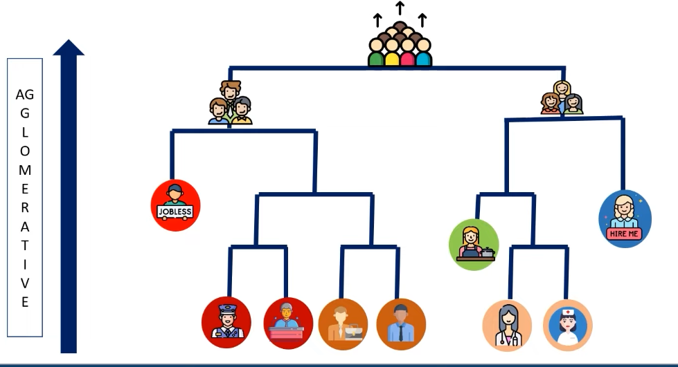
Hierarchical Clustering Algorithm
Creates a hierarchy of clusters rather than a fixed number of groups
Useful for visualizing relationships between data points

Slide 3
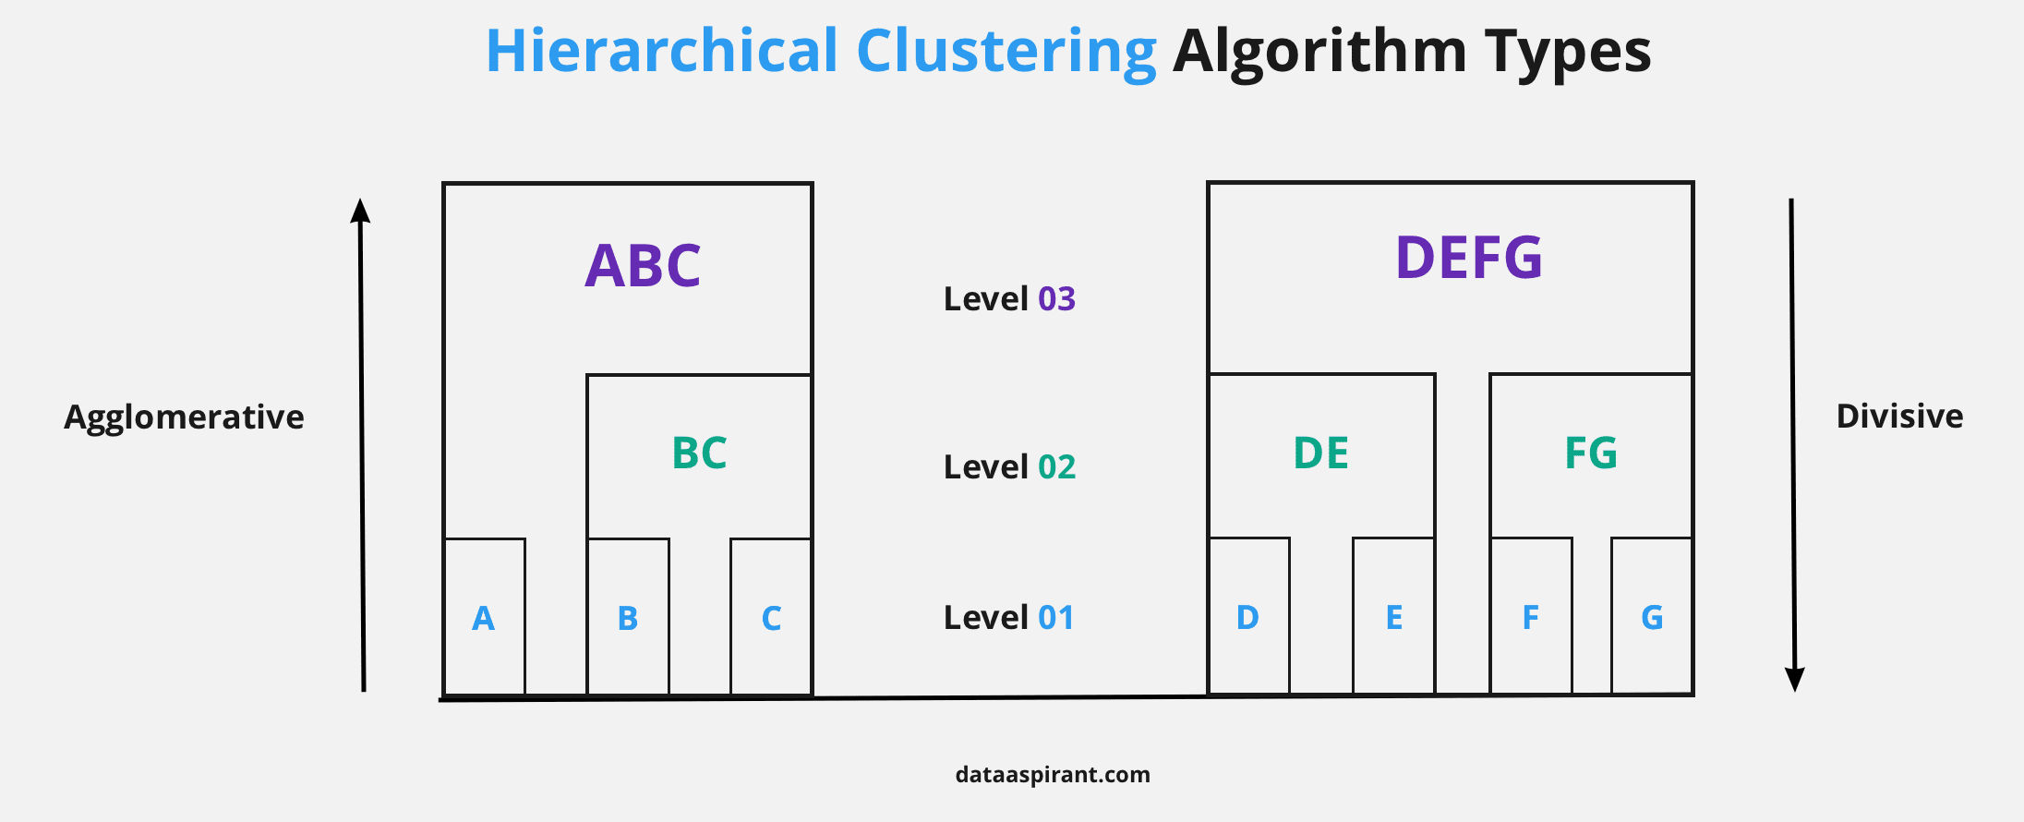
Types of Hierarchical Clustering
Agglomerative (Bottom-Up Approach)
Divisive (Top-Down Approach)
Agglomerative clustering is more commonly used in practice!

Slide 4
Hierarchical Clustering (Agglomerative Approach)
1️⃣ Compute Distance Matrix
Calculate the distance between every pair of data points using metrics like:
Euclidean Distance
Manhattan Distance
Cosine Similarity
2️⃣ Merge Closest Clusters
Identify the two closest clusters and merge them into a new cluster
3️⃣ Update the Distance Matrix
Recalculate the distance between the new cluster and the remaining clusters
4️⃣ Repeat Until One Cluster Remains
Continue merging until all points form a single cluster

Slide 5
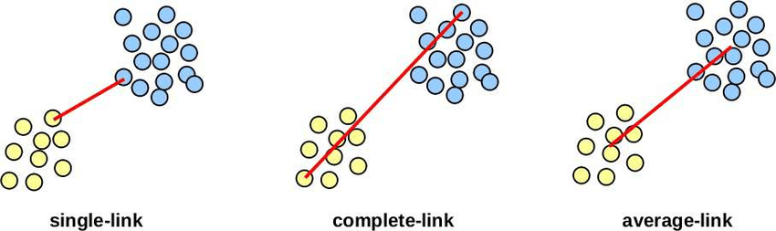
Linkage Methods in Hierarchical Clustering
How do we measure the distance between clusters?
🔹 Single Linkage (Minimum Distance)
Distance between the closest points in two clusters
🔹 Complete Linkage (Maximum Distance)
Distance between the farthest points in two clusters
🔹 Average Linkage
Mean distance between all points in two clusters
🔹 Centroid Linkage
Distance between the centroids of two clusters
Centroid-link

Slide 6
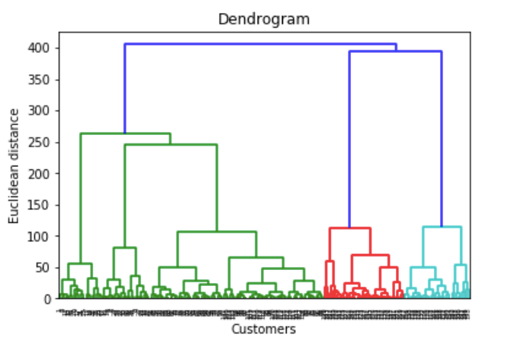
Dendrogram: The Hierarchical Tree Structure
A tree-like diagram that shows how clusters are merged
Helps determine the optimal number of clusters
Cutting the dendrogram at a certain level gives the final clusters

Slide 7
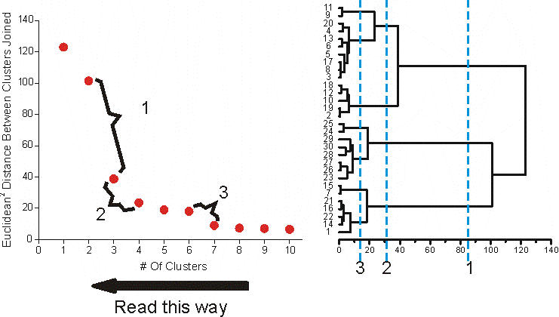
Choosing the Number of Clusters
How do we decide where to "cut" the dendrogram? ✂
Identify a large jump in distance between merges
Look for a natural grouping in the dendrogram

Slide 8
Advantages and Disadvantages of Hierarchical
Advantages of Hierarchical Clustering ✅
✔ No need to predefine the number of clusters (K) ✔ Produces a dendrogram, which helps understand data structure ✔ Works well for small to medium-sized datasets ✔ Captures hierarchical relationships between data points
Disadvantages of Hierarchical Clustering ❌
❌ Computationally expensive for large datasets (O(n²) or O(n³) complexity) ❌ Sensitive to outliers, which can distort the dendrogram ❌ Not scalable for very large datasets due to high memory requirements ❌ Once merged, clusters cannot be split again (Agglomerative approach)

Slide 9
Applications of Hierarchical Clustering
Biological Taxonomy
Classifying species in evolutionary trees
Customer Segmentation
Grouping customers based on purchasing behavior
Document Clustering
Organizing news articles by topics
Example: DNA sequence analysis
Example: E-commerce personalized recommendations
Example: Grouping similar research papers
Image Segmentation
Identifying different objects in an image
Example: Medical image analysis
Anomaly Detection
Finding unusual patterns in cybersecurity or fraud detection

Slide 10
Thank You

